Slide 1
Solar System Ambassador PowerPoint Presentation Standard Branding Slide

Slide 2
2006: A Return to the Moon, But With an Eye on Mars
Template prepared by Steven H. Williams
For the JPL Solar System Ambassador Program
Notes:
Talking Points
Artemis II’s return to the Moon mission will be a item of great interest this year, no doubt. But getting back to lunar space is a stepping stone to the next challenge in Solar System exploration, having astronauts get to Mars!
2026 has a number of important Mars-related anniversaries that have occurred X number of years ago, where “X” is evenly-divisible by 5. Such “round-number” anniversaries seem to attract media attention, making our job of engaging a public audience a lot easier!

Slide 3
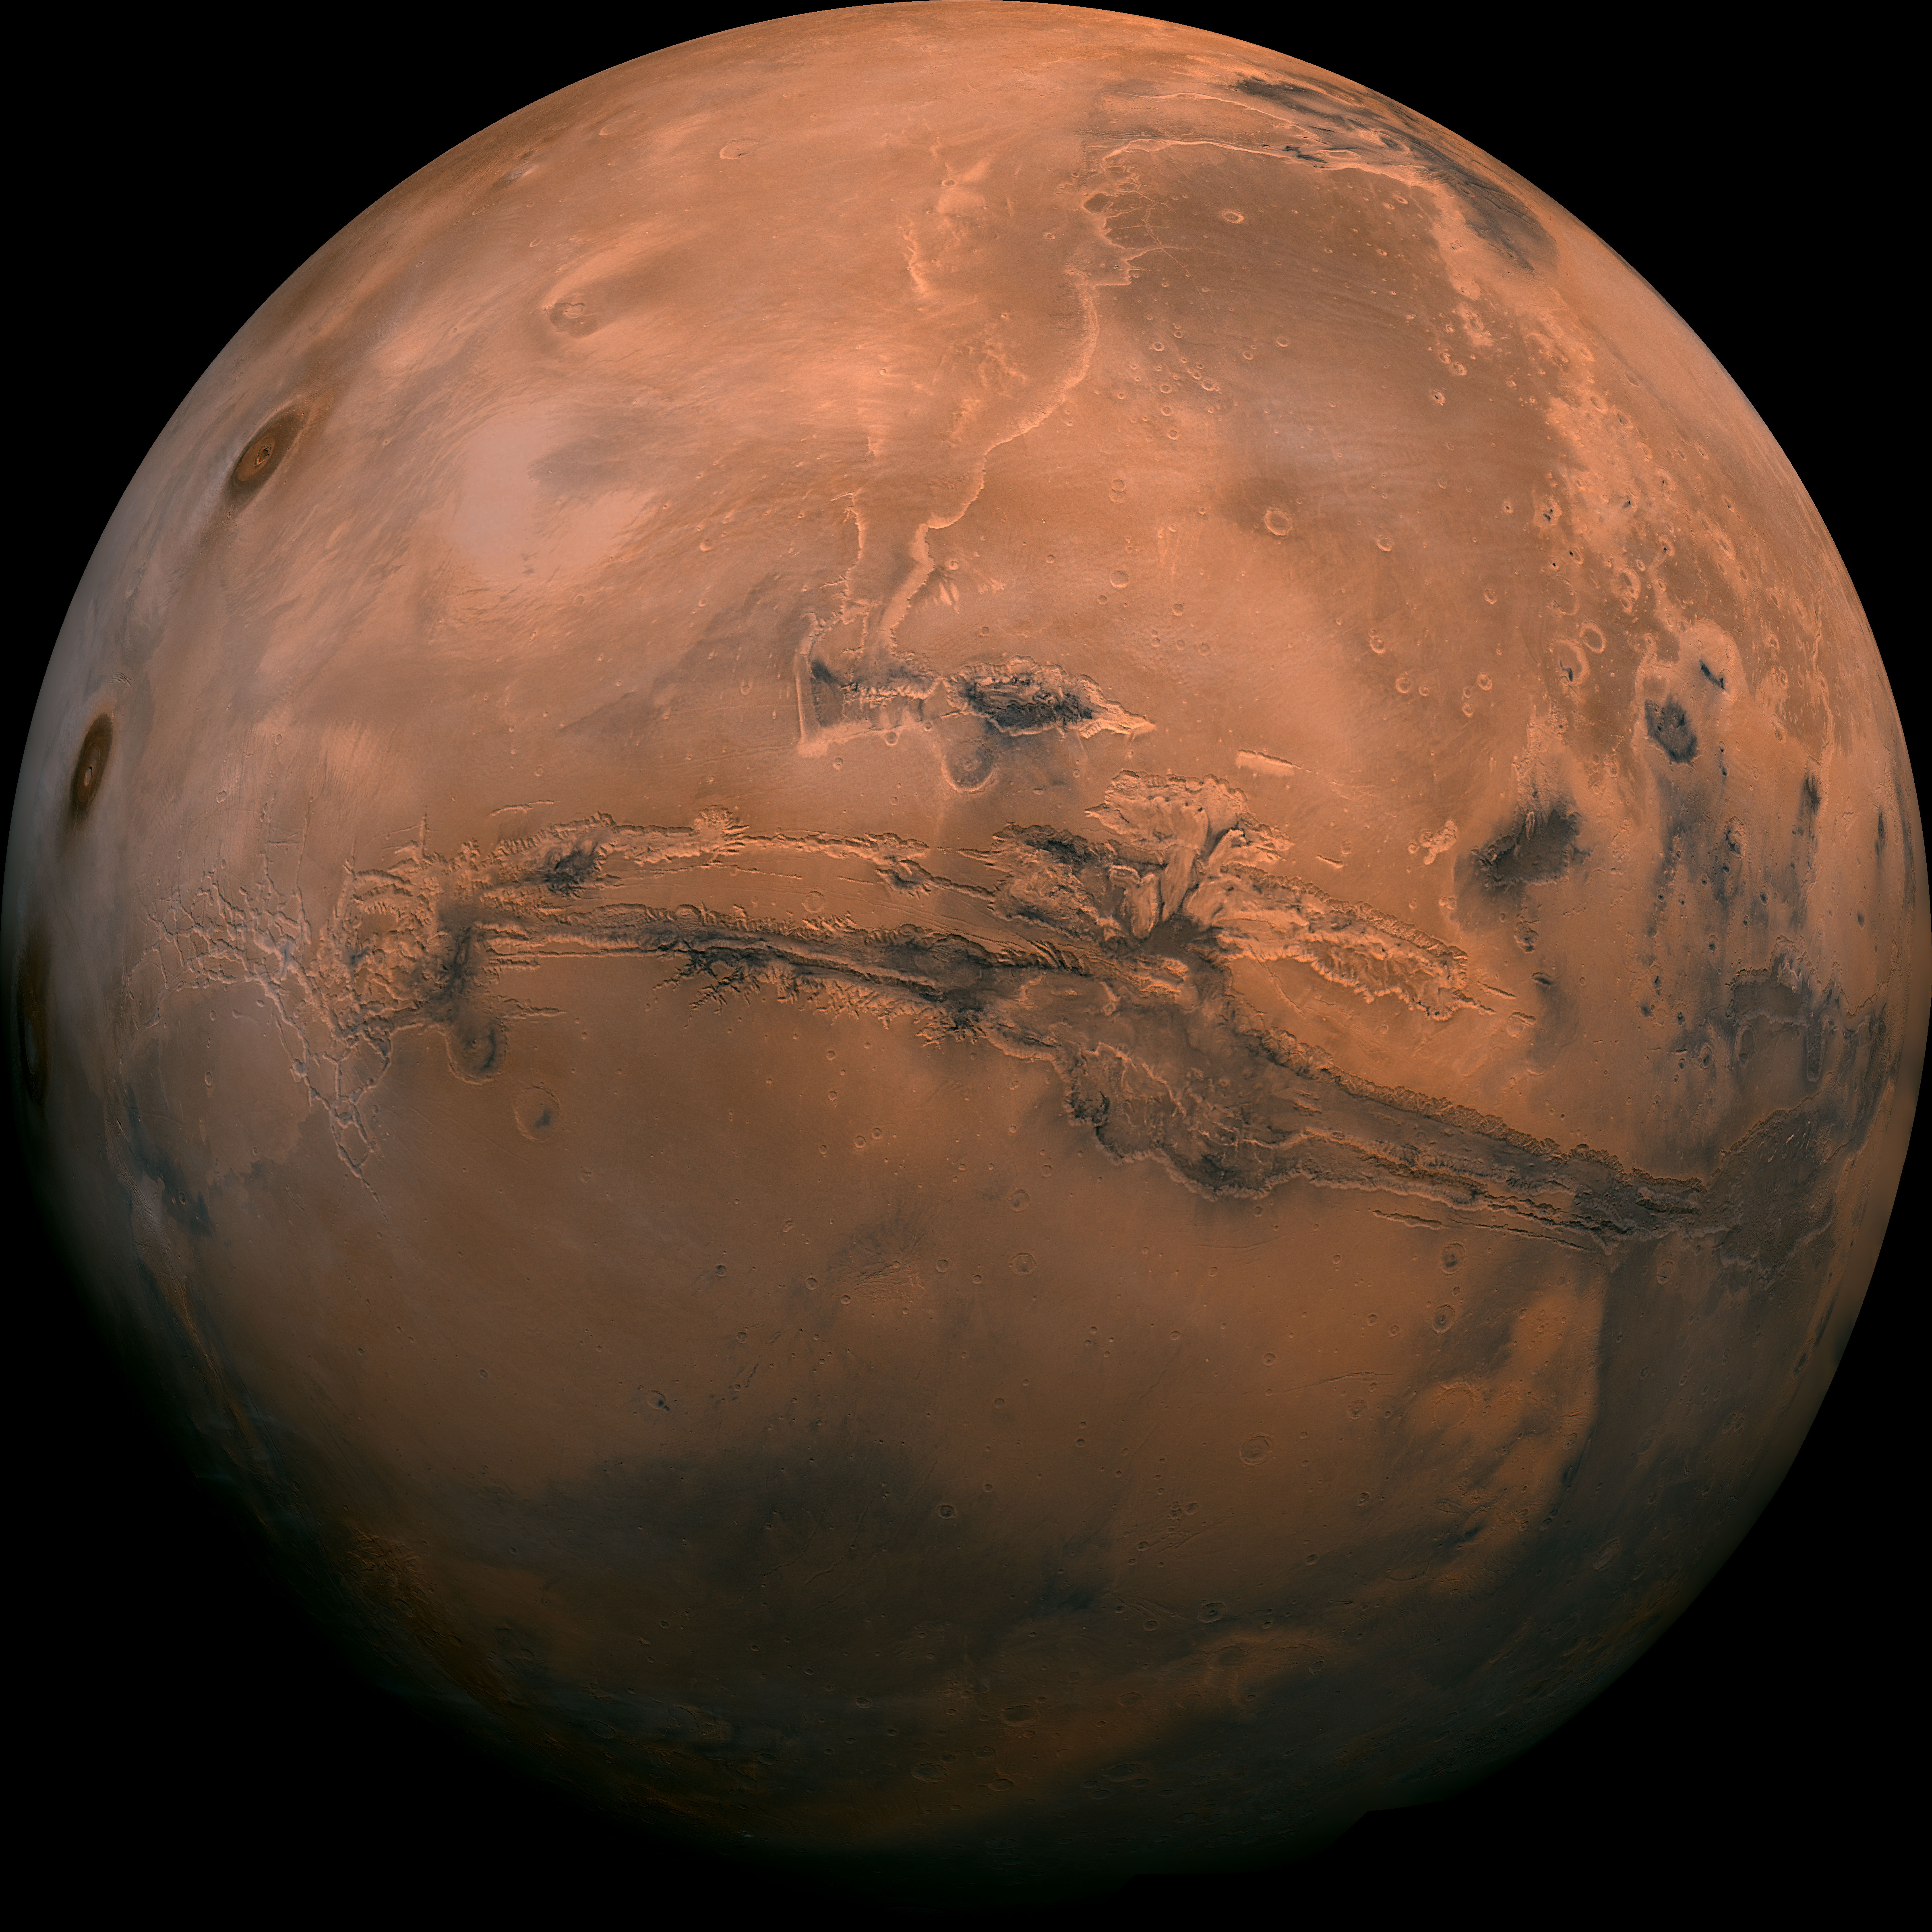

…With an Eye on Mars
Notes:
General References
Mars is Hard Spreadsheet: https://www.airandspacethisweek.com/assets/pdfs/Mars%20is%20Hard%20Mission%20Spreadsheet%20Final%202025.xls
Siddiqi, Asif, Beyond Earth: A Chronicle of Deep Space Exploration 1958-2016: https://www.nasa.gov/connect/ebooks/beyond_earth_detail.html.
The Planetary Society’s Every Mission to Mars: https://www.planetary.org/space-missions/every-mars-mission
EBSCO Mars Landers: https://www.ebsco.com/research-starters/astronomy-and-astrophysics/surface-experiments-mars

Slide 4
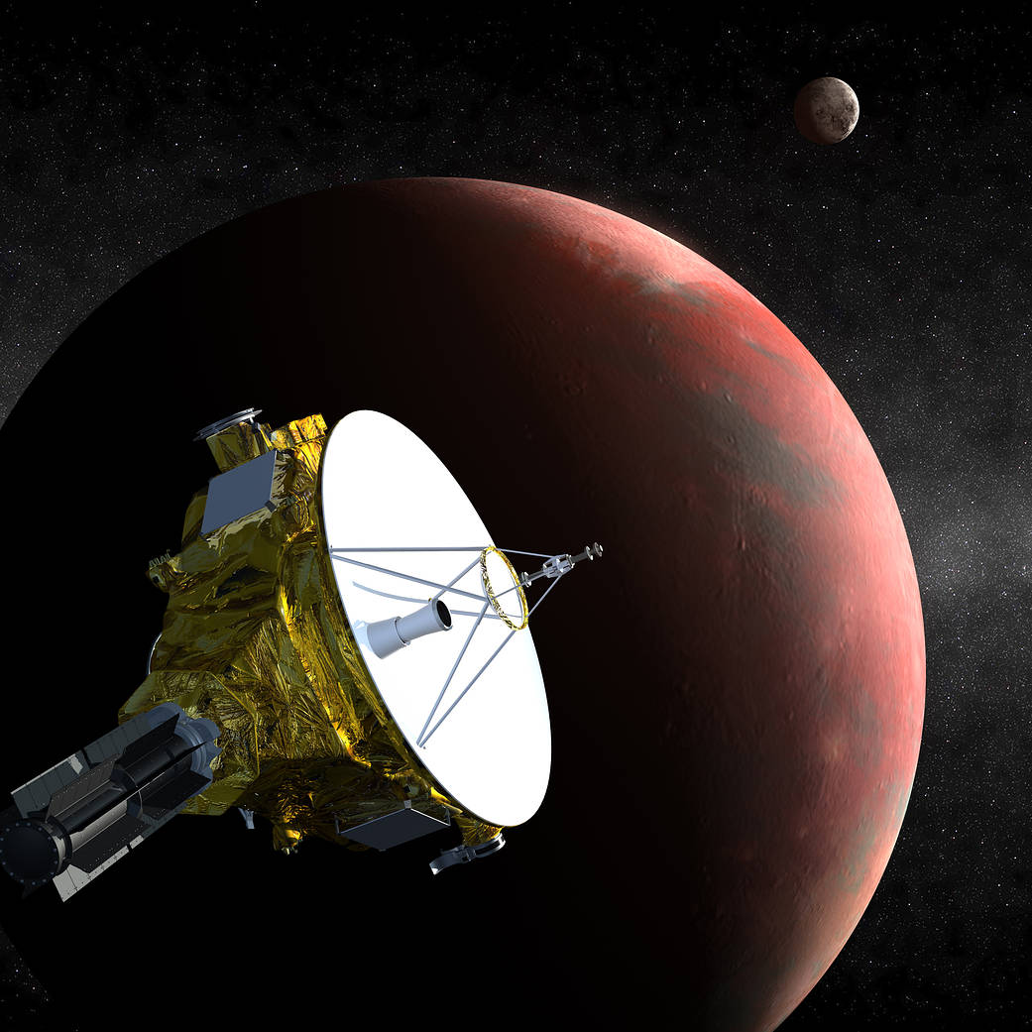
New Horizons Spacecraft Launched
January 19, 2006
Not a Mars Mission of course, but it would fly by Pluto on July 14, 2015, giving us our first look at this new (dwarf) planet, fifty years TO THE DAY after Mariner 4 gave us our first good look at Mars!
Notes:
Talking Points
New Horizons was not on a Mars mission of course, but it would fly by Pluto on July 14, 2015, giving us our first good look at this new (dwarf) planet, fifty years TO THE DAY after Mariner 4 gave us our first good look at Mars!
Queen guitarist Brian May, an Astronomy Ph.D. and member of the New Horizons team, wrote an original piece of music to honor the fly-by: https://www.guitarworld.com/news/listen-to-new-horizons-from-queen-guitarist-brian-may
New Horizons also flew by another KBO, Arrokoth: https://astronomynow.com/2025/02/27/sights-on-a-new-flyby-for-new-horizons. It may fly by others.
References
Science@NASA: https://science.nasa.gov/mission/new-horizons
Mission website: https://pluto.jhuapl.edu/Mission/The-New-Horizons-Mission.php
Smithsonian Magazine: https://www.smithsonianmag.com/innovation/alan-stern-ingenuity-awards-pluto-180957236
The Planetary Society 10 Year After Flyby: https://www.planetary.org/articles/ten-years-after-pluto-new-horizons-faces-a-new-threat

Slide 5
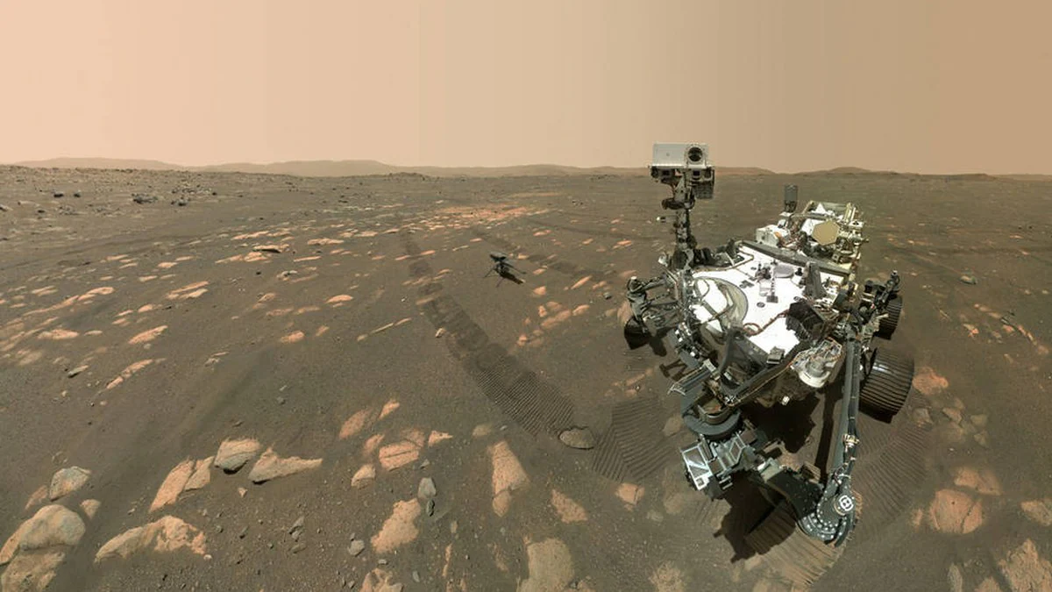
Perseverance Rover Launched
5th Anniversary: February 10
Used sky crane landing system
Landed on delta in Jezero Crater
Ingenuity helicopter planned for test, became scout for rover travel!
“Selfie with Ingenuity visible!
Notes:
Talking Points
Extensive exploration of delta deposits of a river that once flowed into Jezero Crater.
Discovered potential biosignatures: chemistry consistent with biological activity.
Perseverance explored Neretva Vallis, an ancient river channel. The rover could operate until 2031!
References
NASA Science: https://science.nasa.gov/mission/mars-2020-perseverance
NASA Science Five-Year Report: https://science.nasa.gov/mars/the-mars-report/2025-september-special-edition
Potential biosignatures discovered: https://www.nasa.gov/news-release/nasa-says-mars-rover-discovered-potential-biosignature-last-year

Slide 6
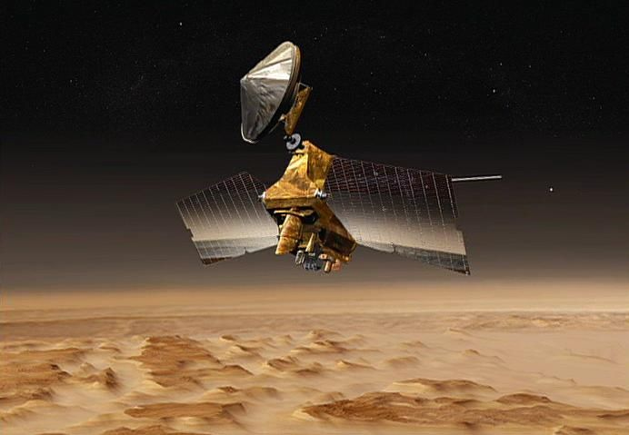
Mars Reconnaissance Orbiter
Mars Orbit Insertion
20th Anniversary: March 10, 2006
High Resolution Imaging Science Experiment
100,000+ amazing images of martian surface
Other instruments: CRISM, MARCI, MCS, SHARAD
SHARAD radar finds sub-surface liquid water (?)
Important part of Mars Relay Network
Notes:
Talking Points
HiRISE camera has acquired more than 100,000 images of the martian surface, including some targets selected by the public.
References
NASA Science: https://science.nasa.gov/mission/mars-reconnaissance-orbiter
JPL: https://www.jpl.nasa.gov/missions/mars-reconnaissance-orbiter-mro
Fact Sheet: https://d2pn8kiwq2w21t.cloudfront.net/documents/MRO_bkLN36d.pdf
HiRISE: https://hirise.lpl.arizona.edu

Slide 7
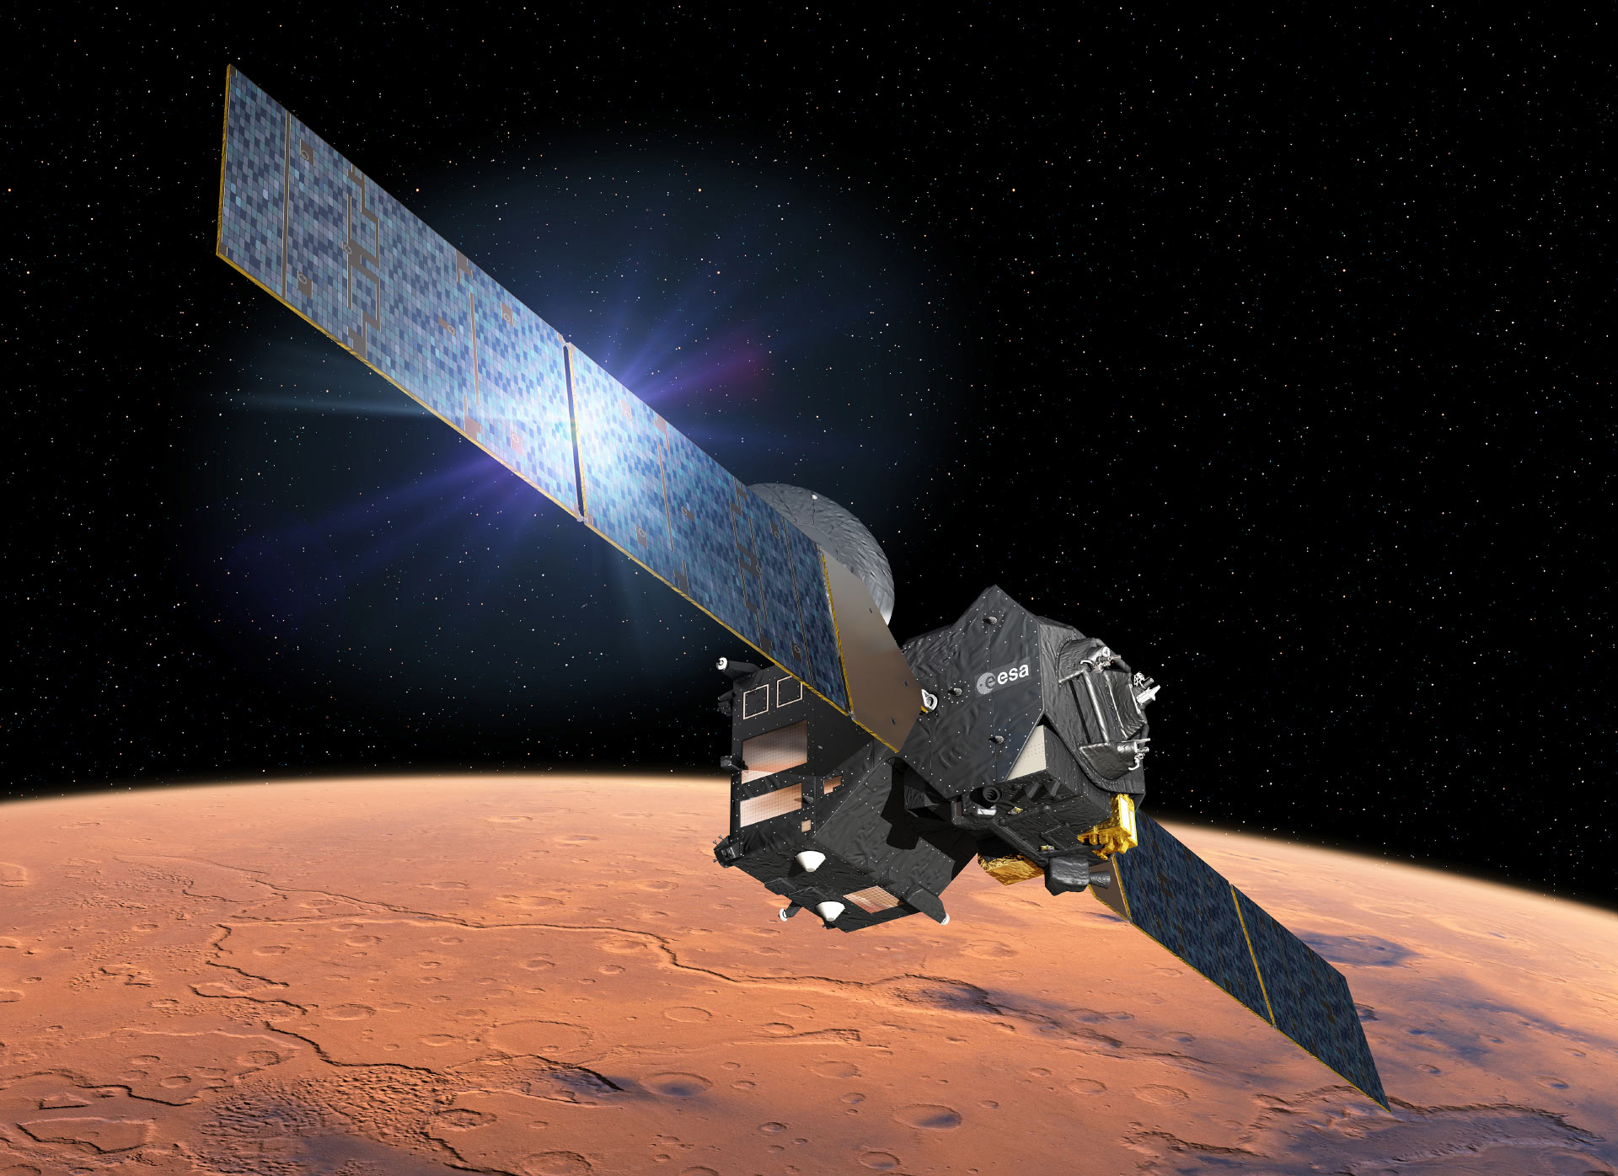
ExoMars Launched
10th Anniversary: March 14
Two two-part spacecraft planned
Joint ESA/Russia mission
First: Trace Gas Orbiter and Schiaparelli lander
TGO was successful; Schiaparelli crashed
Second pair delayed
Rosalind Franklin rover built, delayed
Kazachok lander (Russia) cancelled
Notes:
Talking Points
ExoMars was planned as a double two-part mission. The first part, built by ESA. comprised the Trace Gas Orbiter and the Schiaparelli lander. The TGO was fully successful and is still in operation, including service as a communications relay. Schiaparelli crashed on landing.
The second part of the ExoMars mission was ESA’s Rosalind Franklin rover, to be landed on Mars by the Russian Kazachok lander. ESA suspended its collaboration with Russia due to its invasion of Ukraine. The Rosalind Franklin is in storage awaiting a new ESA lander to be launched by NASA in the near future.
References
ESA: https://www.esa.int/Science_Exploration/Human_and_Robotic_Exploration/Exploration/ExoMars
Trace Gas Orbiter: https://esoc.esa.int/content/exomarstgo
NASA SMD: https://science.nasa.gov/mission/tgo
The Planetary Society: https://www.planetary.org/space-missions/exomars-rover
Wikipedia: https://en.wikipedia.org/wiki/ExoMars

Slide 8
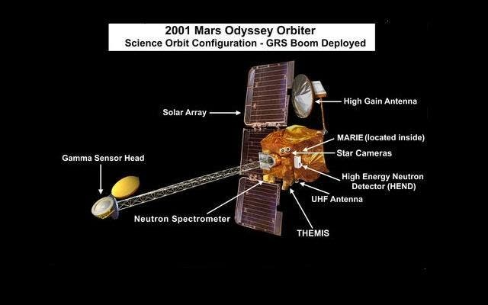
Mars Odyssey Launched
25th Anniversary: April 7
Notes:
Talking Points
Oldest Mars mission still in operation.
Name is a nod to the famous movie, 2001: A Space Odyssey since it was launched in 2001
References
NASA SMD: https://science.nasa.gov/mission/odyssey/science
Mars Odyssey THEMIS: https://themis.asu.edu/factsheet

Slide 9
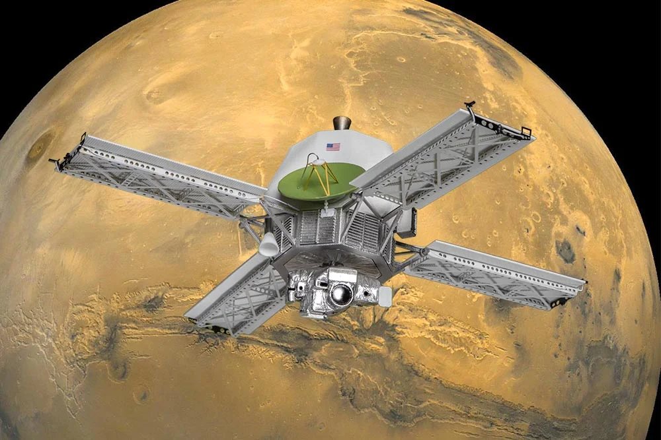
Mainer 9 Launched
55th Anniversary: May 30
Notes:
Talking Points
Mariner 9 was the first spacecraft placed in orbit around another planet (on November 13, 1971).
Mariner 9’s data dispelled misperceptions from previous missions – Mars was much more geologically interesting than previously thought. But still no canals!
Valles Marineris, the largest canyon system known in the Solar System, was named for Mariner 9.
References
NASA Science: https://science.nasa.gov/mission/mariner-9
JPL: https://www.jpl.nasa.gov/missions/mariner-9-mariner-I
EBSCO: https://www.ebsco.com/research-starters/visual-arts/mariner-9-first-spacecraft-orbit-another-planet
Wikipedia: https://en.wikipedia.org/wiki/Mariner_9

Slide 10
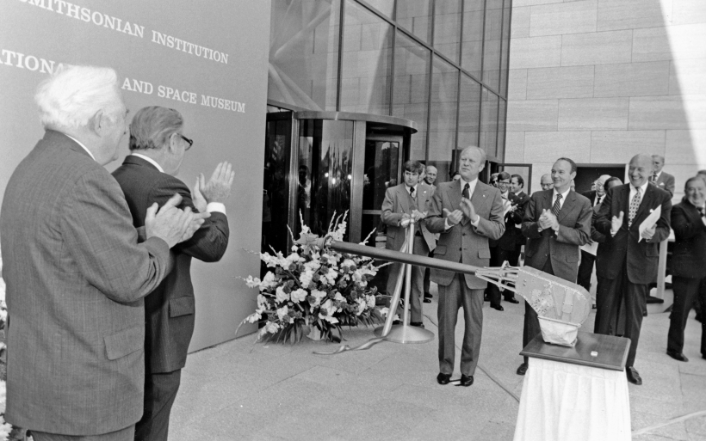
Signal from Viking 1
Cuts Ribbon Opening the
Smithsonian National Air and Space Museum
50th Anniversary: July 1
Notes:
Talking Points
A signal from the Viking 1 spacecraft triggered a replica of the Viking Sample Arm to cut the ribbon dedicating NASM in 1976. President Ford and Apollo 11 astronaut Michael Collins, then NASM Director, and other dignitaries attending.
References
https://siarchives.si.edu/collections/siris_arc_396616
https://airandspace.si.edu/multimedia-gallery/opening1976jpg
https://commons.wikimedia.org/wiki/File:Ribbon_Cutting_Ceremony_at_the_Dedication_of_the_National_Air_and_Space_Museum_of_the_Smithsonian_-_NARA_-_6829642.jpg

Slide 11
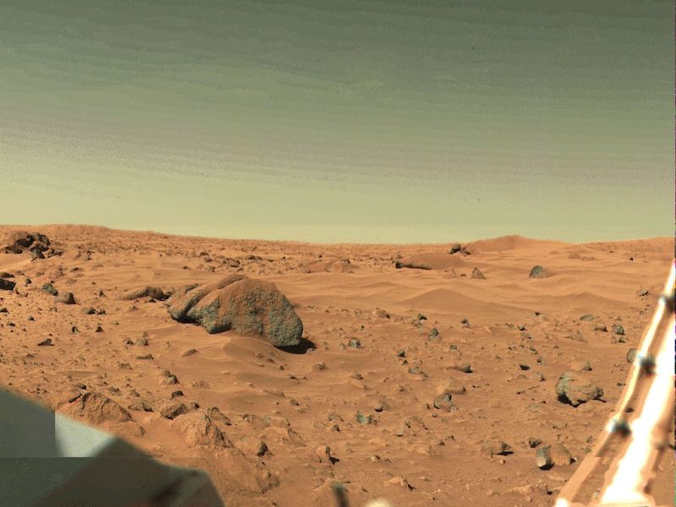
Viking 1 Lands on Mars
50th Anniversary: July 20
First successful Mars lander
Numerous quality images from the orbiter
Experiments to detect active biological activity
Numerous other instruments
Landing site named the “Mutch Memorial Station”
Notes:
Talking Points
First successful Mars lander.
(Almost) landed on USA Bicentennial – delayed for landing site safety determination.
Three biology experiments; controversial results; likely chemistry, not active biology activity
References
NASA Science: https://science.nasa.gov/mission/viking-1
EBSCO: https://www.ebsco.com/research-starters/history/viking-spacecraft-send-photographs-earth-mars
Biology Experiments Revisited: https://www.sciencedirect.com/science/article/pii/S0019103525000132

Slide 12
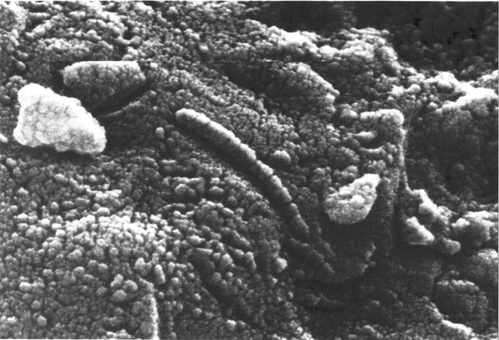
Mars Paleolife Found?
30th Anniversary: August 6
Four lines of evidence; all individually week
“Lowest common denominator” argument
Evidence insufficiently extraordinary
Excellent example of how science inquiry operates!
Notes:
Talking Points
Evidence strong enough for “hypothesis,” but not enough for a “theory”
Huge public reaction to notice; touches on biology, geology, philosophy, and theology.
Found in martian meteorite ALH84001. Evidence for Mars origin of this and some other meteorites was strong enough for immediate acceptance; evidence for paleolife, not-so-much. Good example of scientific method.
References
Allan Treiman: https://www.lpi.usra.edu/lpi/meteorites/alhnpapers_archive.html
University of Oregon: https://pages.uoregon.edu/imamura/121/life/alh84001.html
https://opentools.ai/news/nasas-1996-martian-meteorite-revelation-a-scientific-game-changer

Slide 13
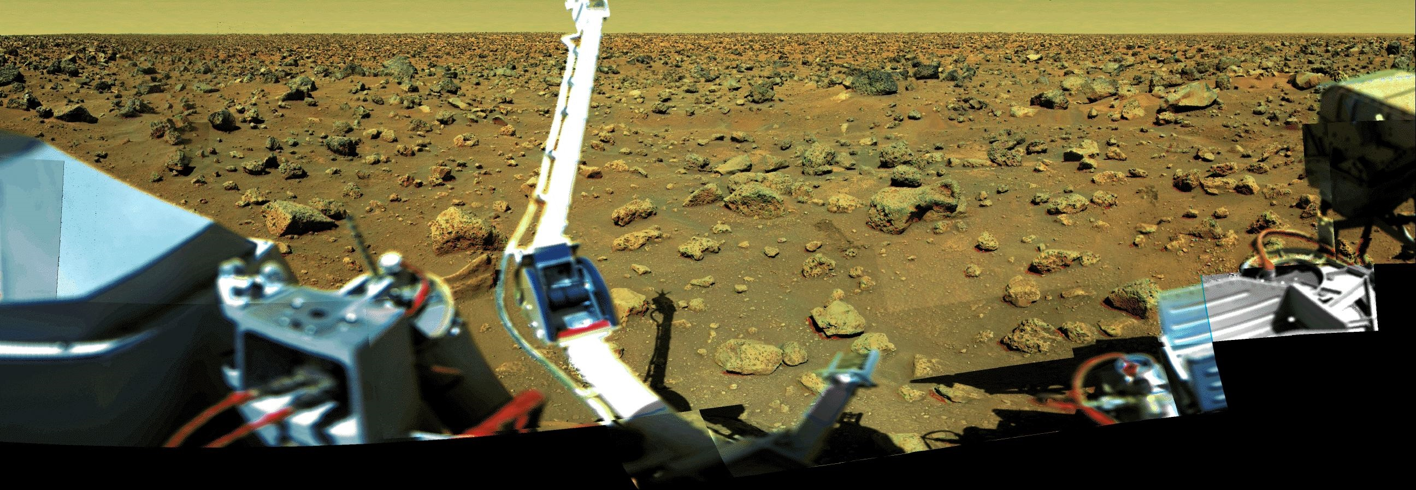
Viking 2 Lands on Mars
50th Anniversary: September 3
Twin to Viking Lander 1
Landing site named Gerald Soffen Memorial Station (Viking Project Scientist)
Notes:
Talking Points
Successful orbiter/lander pair; complementary to Viking 1.
Landing site named Gerald Soffen Memorial Station, after the Viking Project Scientist.
References
JPL: https://www.jpl.nasa.gov/missions/viking-2
NASA Fact Sheet: https://d2pn8kiwq2w21t.cloudfront.net/documents/viking_YBc3kvY.pdf
Wikipedia: https://en.wikipedia.org/wiki/Viking_2

Slide 14
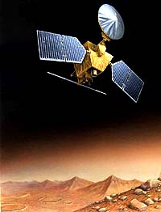
Mars Global Surveyor Launched
30th Anniversary: November 7
Saved fuel by aerobraking
Prelude to Mars Reconnaissance Orbiter
Operated in Mars orbit for 10 years
Two mission extensions
Helped in landing site selections
Also supported other missions as relay
Notes:
Talking Points
MGS provided datasets that would dovetail with those from the Mars Reconnaissance Orbiter.
Scouted potential landing sites for the Phoenix lander and the Curiosity rover.
Global weather, geological, magnetic field, and gravitational field measurements.
References
NASA Science: https://science.nasa.gov/mission/mars-global-surveyor
JPL: https://www.jpl.nasa.gov/missions/mars-global-surveyor
Wikipedia: https://en.wikipedia.org/wiki/Mars_Global_Surveyor

Slide 15
Mariner 9
Mars Orbit Insertion
55th Anniversary: November 13
Notes:
Talking Points
Mariner 9 was the first spacecraft placed in orbit around another planet.
Mariner 9’s data dispelled misperceptions from previous missions – Mars was much more geologically interesting than previously thought.
Valles Marineris, the largest canyon known in the Solar System, was named for Mariner 9.
Abundant evidence of past water flow on the martian surface.
References
NASA Science: https://science.nasa.gov/mission/mariner-9
JPL: https://www.jpl.nasa.gov/missions/mariner-9-mariner-I
EBSCO: https://www.ebsco.com/research-starters/visual-arts/mariner-9-first-spacecraft-orbit-another-planet
Wikipedia: https://en.wikipedia.org/wiki/Mariner_9

Slide 16
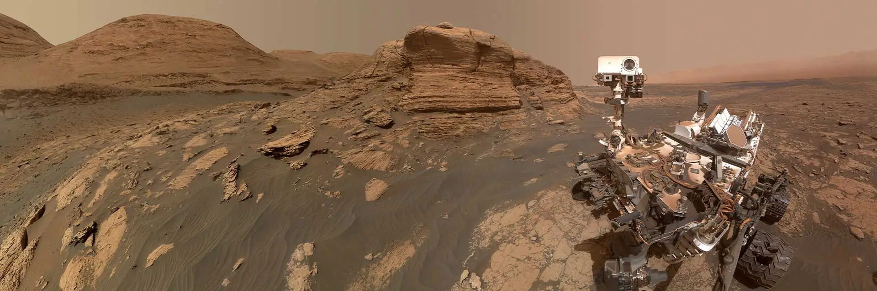
Curiosity Rover Launched
15th Anniversary: November 26
Originally named “Mars Science Laboratory”
Landed on Mt. Sharp, a Gale Crater lake bottom deposit
First use of “sky crane” landing system
Still in full operation
Notes:
Talking Points
“Curiosity” was sixth-grade student Clara Ma’s winning entry in NASA’s Name-the-Rover contest in 2009. continuing the custom of NASA in naming important spacecraft (e.g. Spirit, Opportunity, Perseverance, Ingenuity, etc.)
Site’s proper name is Aeolus Mons, but scientists prefer “Mt. Sharp” to honor famous scientist Robert Sharp.
References
NASA Science: https://science.nasa.gov/mission/msl-curiosity
National Space Society: https://nss.org/wp-content/uploads/Mars-Science-Laboratory-Fact-Sheet.pdf
Wikipedia: https://en.wikipedia.org/wiki/Mars_Science_Laboratory

Slide 17
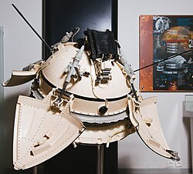
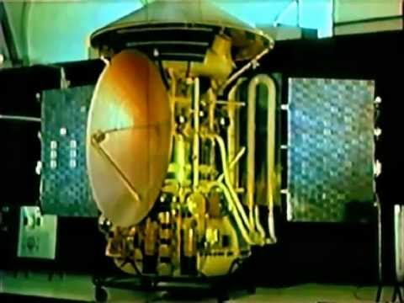
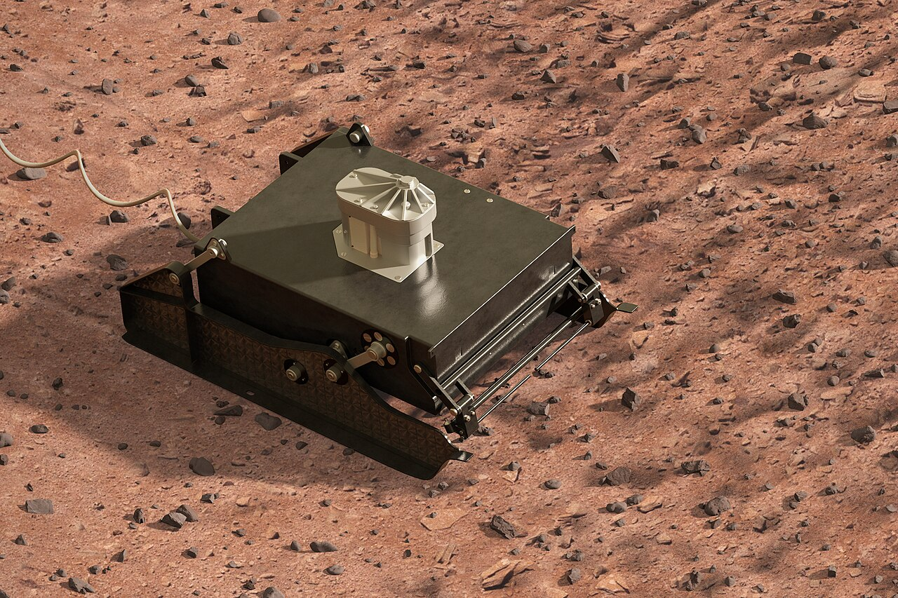
Mars 2 Spacecraft
Crash-lands on Mars
55th Anniversary: November 27
Lander
PrOP-M “rover”
Mars 2 Spacecraft
Notes:
Talking Points
First spacecraft to land on another planet. It’s lander crashed, but the orbiter portion did return some data.
A raging global dust storm inhibited imaging and other data acquisition.
References
Wikipedia: https://en.wikipedia.org/wiki/Mars_2
EBSCO: https://www.ebsco.com/research-starters/history/mars-2-first-spacecraft-impact-mars
https://web.archive.org/web/20210121201508/https://nssdc.gsfc.nasa.gov/nmc/spacecraft/display.action?id=1971-045D

Slide 18
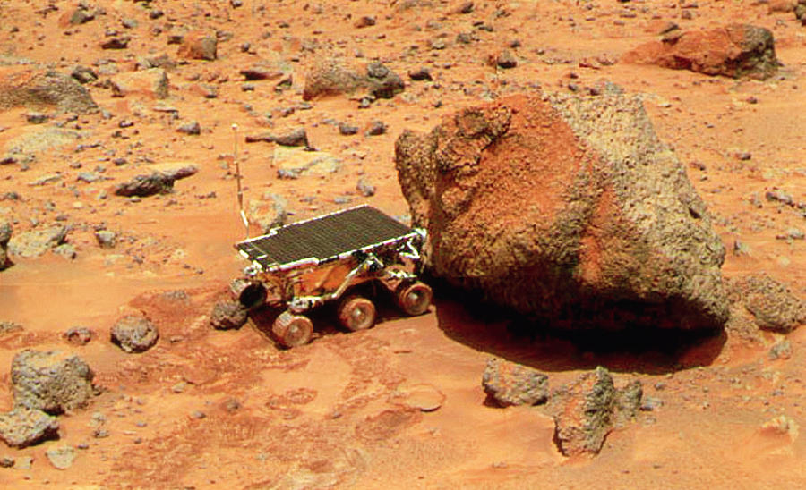
Mars Pathfinder Launched
30th Anniversary: December 4
First wheeled rover on Mars
First mission with significant internet support
Landed on July 4, 1997
Huge interest!
  Radio-controlled rover
  Whimsical rock names
Notes:
Talking Points
Pathfinder was the first Mars mission with significant internet support. From its landing on July 4, 1997, the MPF website had 265 million hits in only five days, necessitating NASA’s first use of mirror sites!
Popularity of the mission was augmented by two facts: Its Sojourner rover (the first wheeled rover on Mars) was like a radio-controlled car, extremely popular at the time, and the Mars team took to naming the rocks it was examining after cartoon characters. Both features were especially popular with the younger, more tech-savvy audience!
Pioneered the airbag landing technique.
MPF landing site was named the “Sagan Memorial Station.”
References
NASA Science: https://science.nasa.gov/mission/mars-pathfinder
JPL: https://www.jpl.nasa.gov/missions/mars-pathfinder-sojourner-rover
The Planetary Society: https://www.planetary.org/space-missions/pathfinder
Mirror site use: https://
Mars www.route-fifty.com/digital-government/1997/07/mirror-sites-let-nasa-keep-mars-in-view-on-web/308160

Slide 19
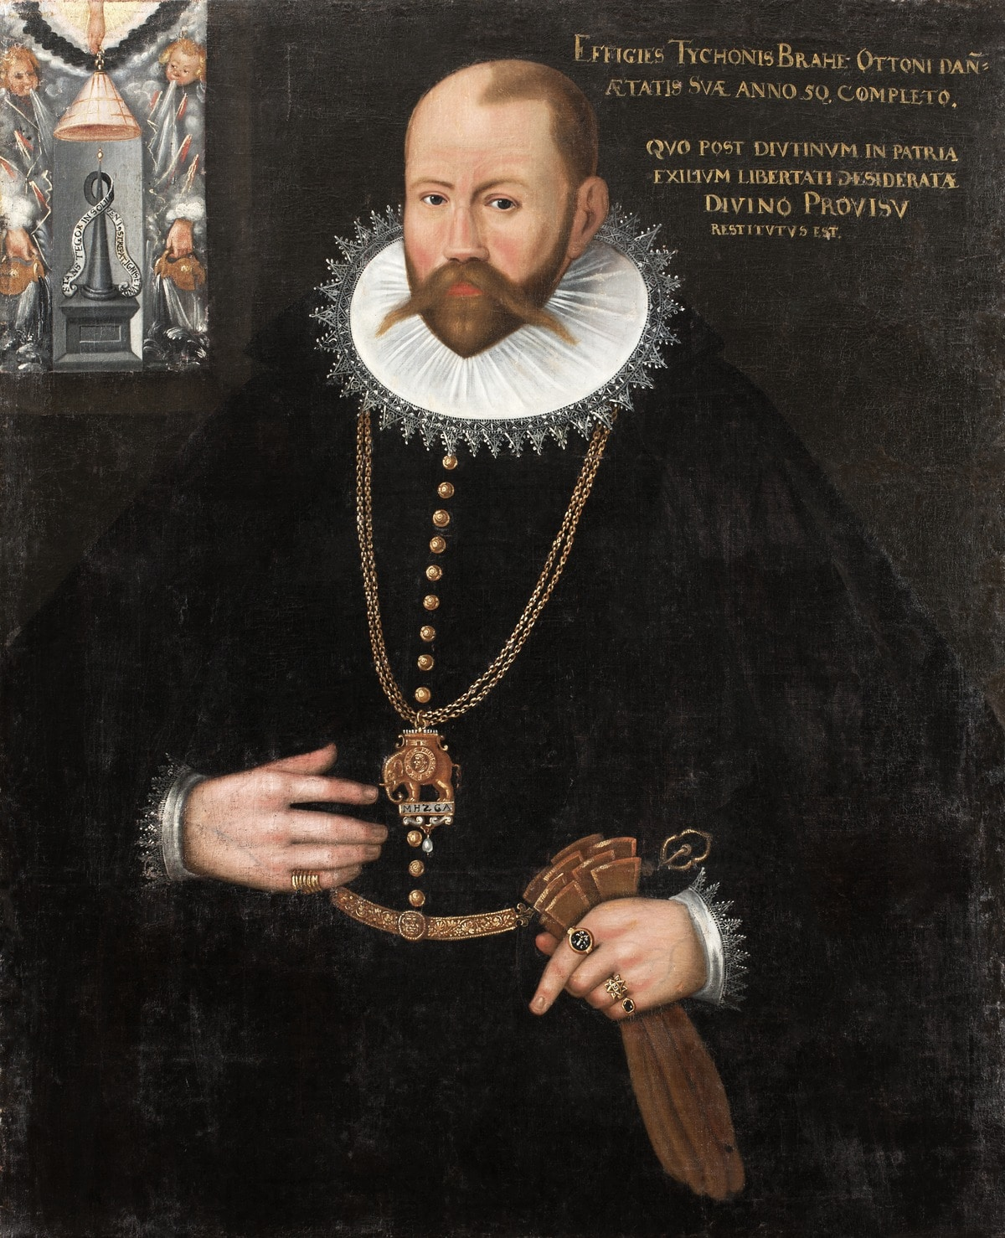
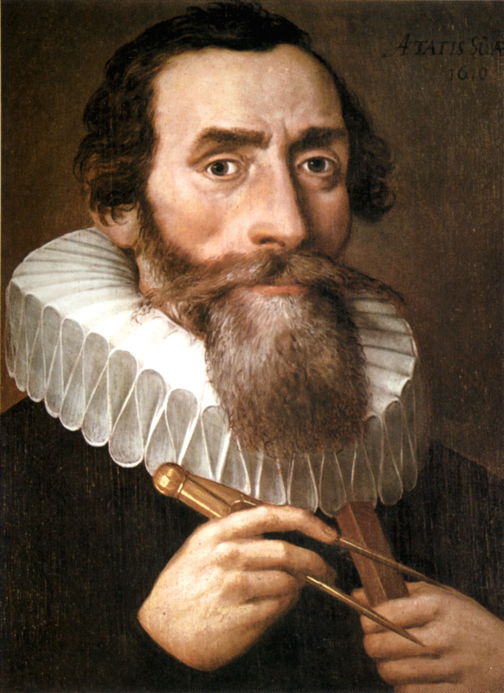
December 27
Tycho Brahe’s 480th Birthday
Johannes Kepler’s 455th Birthday
Made Key Observations of Mars’ Position Used Observations to Derive Laws of Planetary Motion
Notes:
Talking Points
Brahe: Lived 1546 – 1601 CE. Renaissance Danish astronomer. Master of pre-telescope positional astronomy, especially for Mars. His measurements were extremely precise for the day, but he lacked the skill to use them effectively.
Kepler: Live from 1571 to 1630. Observed a “new” star in Cassiopeia in 1572. It would become as bright as Venus temporarily. We know it today as a supernova, but it was the first time in human history something new happened among the “fixed stars,” a serious upset to the prevailing opinion of heavens without change. This set the stage for Galileo’s discoveries in 1610-11!
NOTE: Brahe’s birthday was adjusted due to the conversion from the Julian to the Gregorian calendar in 1752.
Kepler became Brahe’s assistant, and used the Mars observations to derive his famous “Three Laws of Planetary Motion.” Kepler would author the Rudolphine Tables, an important catalog of star and planetary positions.
References
Wikipedia: https://en.wikipedia.org/wiki/Tycho_Brahe and https://en.wikipedia.org/wiki/Johannes_Kepler
Tycho’s Star: https://en.wikipedia.org/wiki/SN_1572
Mac Tutor: https://mathshistory.st-andrews.ac.uk/Biographies/Brahe https://mathshistory.st-andrews.ac.uk/Biographies/Kepler

Slide 20
CONCLUSIONS

Slide 21
Solar System Ambassador PowerPoint Presentation Standard Branding Slide

